Slide 1


SENALingua
Erik Santiago Alegría Rojas
Karen Vanessa Castañeda Morán
Cristian David Yalanda Pillimue
Emmanuel Bonilla Salazar
Andrés Felipe Montano Bernal
Karen Niheidy Pastás Valencia

Slide 2

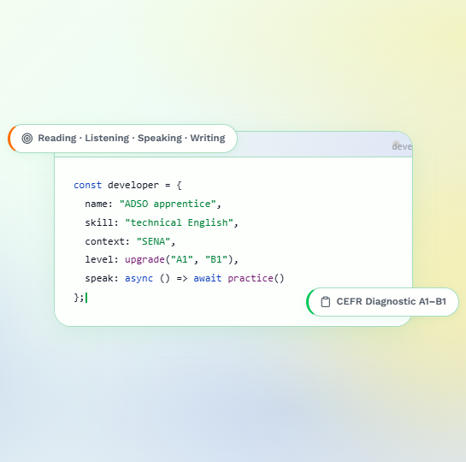
PROJECT OVERVIEW
Target Audience: Specialized for SENA software development trainees.
Core mission: Drives transition from technical language barriers to industry-ready proficiency.
Platform architecture: Integrates adaptive learning paths, real-time skill practice, and instructor performance metrics.

Slide 3
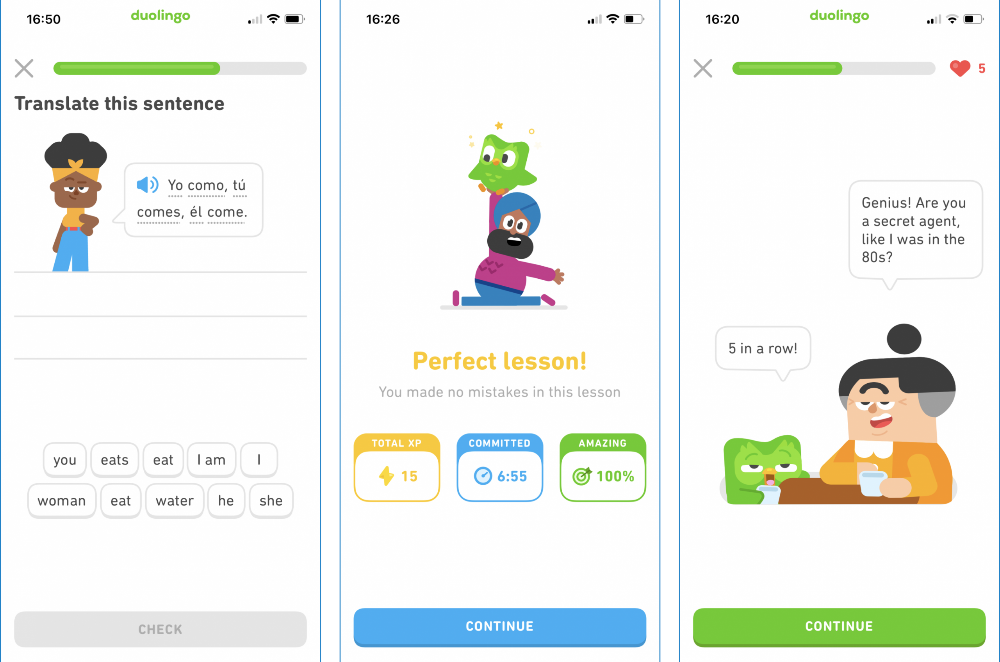
ORIGIN OF THE IDEA
We identified a significant lack of student engagement and technical language proficiency.
Existing market applications offered repetitive exercises.
Consequently, we designed a tailored educational solution to address these specific gaps.

Slide 4
PROJECT RELEVANCE
It offers the most specialized content for software development trainees.
Students can access learning modules from any device, making technical training much more accessible.
It provides better tracking so learners can monitor their skills in real time.

Slide 5






DEVELOPMENT PROCESS
First, we defined the core problem, objectives, and functionalities.
Then, tasks were organized using Agile (Scrum) and Kanban.
After that, the interface was designed in Figma and code was managed in GitHub.
Finally, the system was successfully developed and tested.

Slide 6
MAIN FEATURES
Our application allows users to achieve a better command of technical English through interactive challenges.
One of the most useful features is real-time activity tracking.
It provides faster and more accurate progress monitoring than traditional methods.

Slide 7
APPLIED TECHNOLOGIES
We have implemented HTML5, CSS3, TypeScript, JavaScript, and Tailwind CSS for responsive frontends.
We have integrated Python and SQL databases for secure backend management.
We have used Figma for UI design and GitHub for version control.

Slide 8
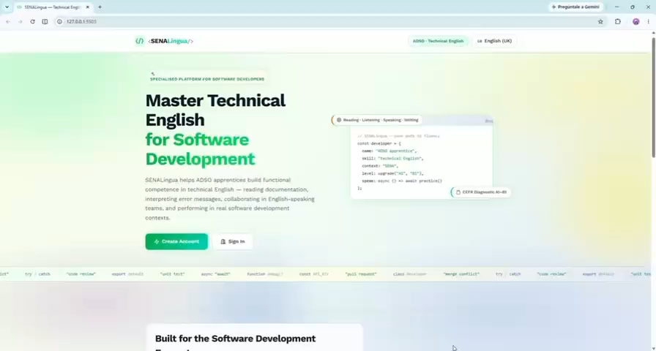
SENALINGUA: SYSTEM INTERFACE AND VISUAL DEMO

Slide 9
CONCLUSION
SENALingua equips SENA developers for global tech

Slide 10
THANK YOU FOR YOUR TIME

